Slide 1
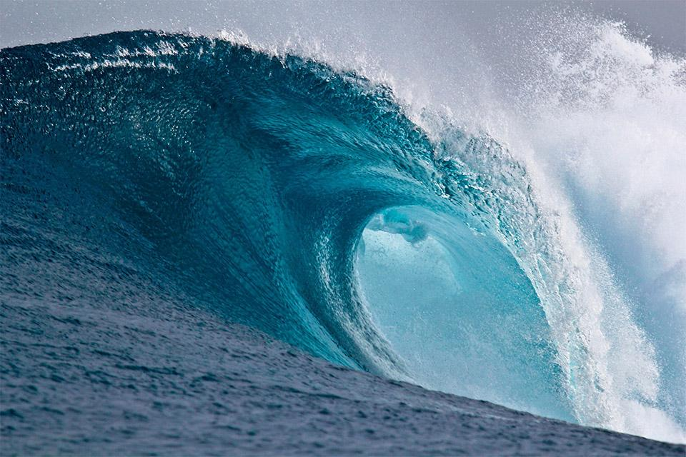
Water Management
Team Amwag
David - Giulia - Mike - Stephan - Uta

Slide 2
Idea
We are using UN free data on water consumption on 200 countries for the past
50 years.
End goal - (1) create an interactive website that can predict possible effects on targets by tweaking parameters (ex : population , water supply and use)
(2) A presentation on correlations and clustering of countries based on water use habits

Slide 3
Current updates
Streamlit app is already on air and working without errors:
- Introduction and About us page updated
- Module page is updated
- Forecast page its create and updated
Forecast it’s showing two types of predictions
- VAR because variables influence each other.
- Holt-Winters considers just one variable at time.

Slide 4
Final Week - The Last Milestone
Finish the Clustering
Create a page for the Clustering
Update the Streamlit app - create a HTTPS link and QR-code
Create and organize the presentation
Clean and organize the github repository

Slide 5
Current challenges
Clustering based on Country similarities:
- Reduce the dimension of the data
- PCA isn’t applicable - still give us too many components
Streamlit website - incorporate the clustering page and doing final updates

